Slide 1

HAPPY POLICE
Group 2
Bergman, Annalyse
Elangovan, Elamathi
Marshall, Ryan
Rai, Meena
Samuel, Joshua

Slide 2
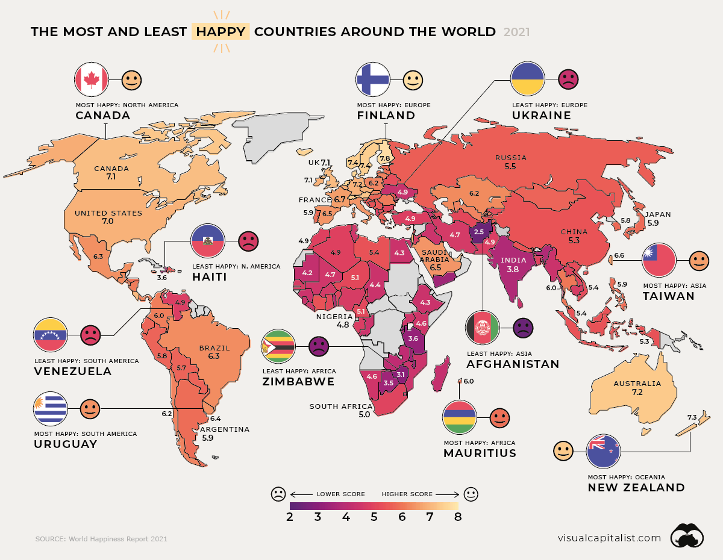
HAPPINESS AROUND THE WORLD
United States Happiness Ranking: Sixteenth
https://www.visualcapitalist.com/mapped-global-happiness-levels-in-2021/
https://www.kaggle.com/datasets/mathurinache/world-happiness-report?select=2020.csv
Notes:
United States Happiness Ranking (2021): Sixteenth

Slide 3
Obesity and Happiness Correlation - I
Null Hypothesis (H₀) | Alternative Hypothesis (H_{A})
There is no correlation between obesity and happiness C_{H0} = 0 | H_{A1}: There is a positive correlation between obesity and happiness C_{H-A1} > 0
 | H_{A2}: There is a negative correlation between obesity and happiness C_{H-A2} < 0
Notes:
Correlation coefficient value is 0.57

Slide 4
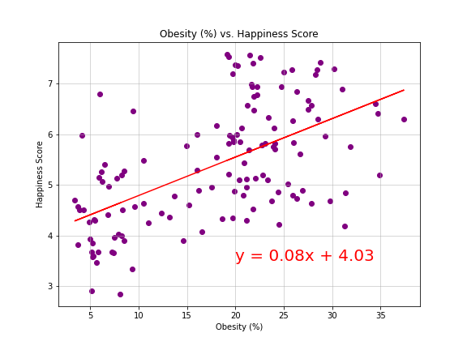
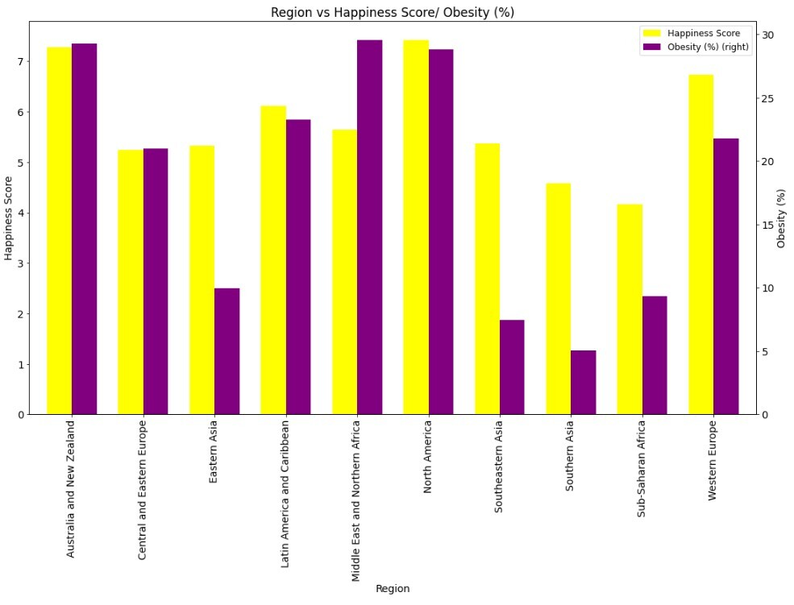
Obesity and Happiness Correlation - II
Correlation coefficient value is 0.57
Moderate Positive Correlation
Resource: https://www.who.int/data/gho/data/indicators/indicator-details/GHO/prevalence-of-obesity-among-adults-bmi-=-30-(age-standardized-estimate)-(-)

Slide 5
Obesity and Happiness Correlation - II
Correlation coefficient value is 0.57
Moderate Positive Correlation
Conclusion
Reject → null Hypothesis and alternative hypothesis H_{A1}
Accept → alternative hypothesis H_{A2}
Resource: https://www.who.int/data/gho/data/indicators/indicator-details/GHO/prevalence-of-obesity-among-adults-bmi-=-30-(age-standardized-estimate)-(-)

Slide 6
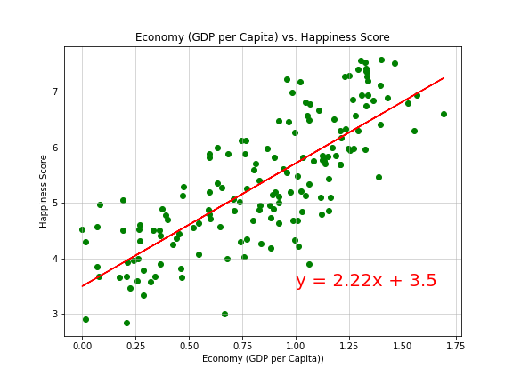
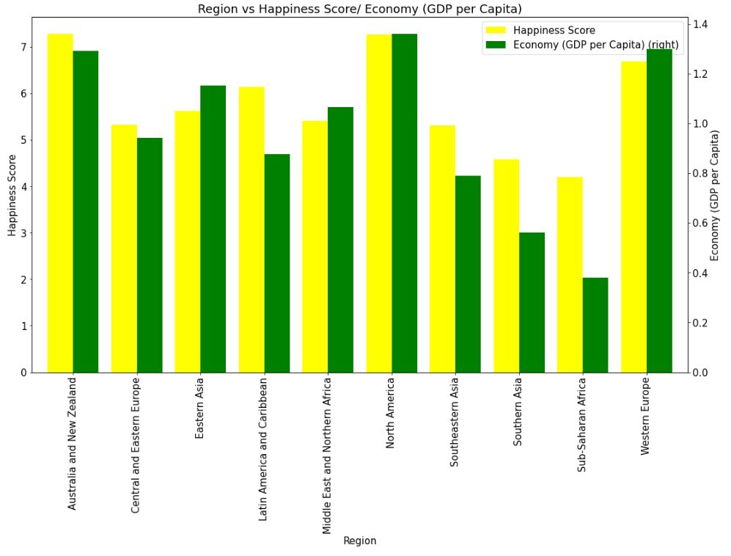
Economy and Happiness Correlation
Correlation coefficient value is 0.78
Strong Positive Correlation
Resource:
https://www.kaggle.com/datasets/mathurinache/world-happiness-report?select=2020.csv
Notes:
Values between 0.3 and 0.7 (-0.3 and -0.7) indicate a moderate positive (negative) linear relationship via a fuzzy-firm linear rule. Values between 0.7 and 1.0 (-0.7 and -1.0) indicate a strong positive (negative) linear relationship via a firm linear rule.

Slide 7
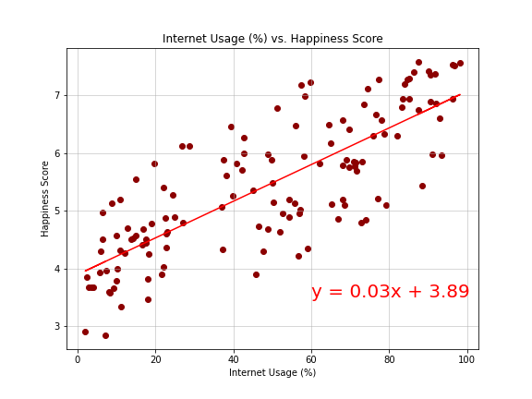
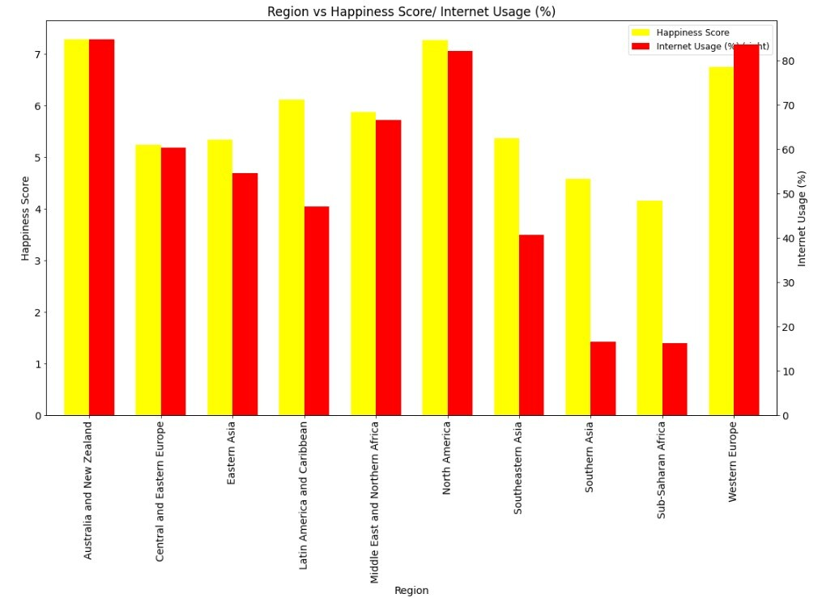
Internet and Happiness Score Correlation
Correlation coefficient value is 0.8
High Positive Correlation
Resource:
https://databank.worldbank.org/
Notes:
Correlation coefficient value is 0.8
Internet addition - leverage the short-term, dopamine-driven feedback loops, the very same neural circuitry used by slot machines and cocaine to keep us using their products as much as possible.

Slide 8
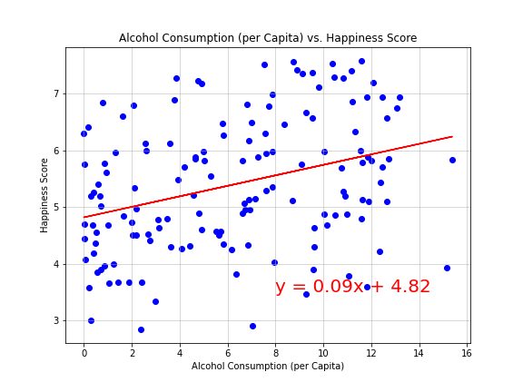
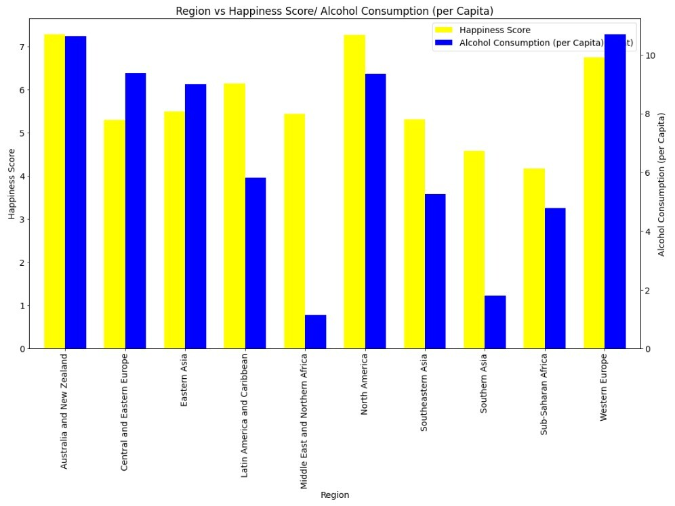
Alcohol Consumption and Happiness Correlation
Correlation coefficient value is 0.34
Weak Positive Correlation
Resource:
https://www.who.int/data/gho/data/indicators/indicator-details/GHO/alcohol-total-per-capita-(15-years)-consumption-(in-litres-of-pure-alcohol)
Notes:
Correlation coefficient value is 0.34
Since alcohol can increase the body's production of dopamine and serotonin, two of the body's 'happy hormones', it can temporarily make us feel less anxious. Long term drinking, however, can lower levels of both these hormones as well as lowering blood sugar and increasing dehydration, leading to worse anxiety.

Slide 9
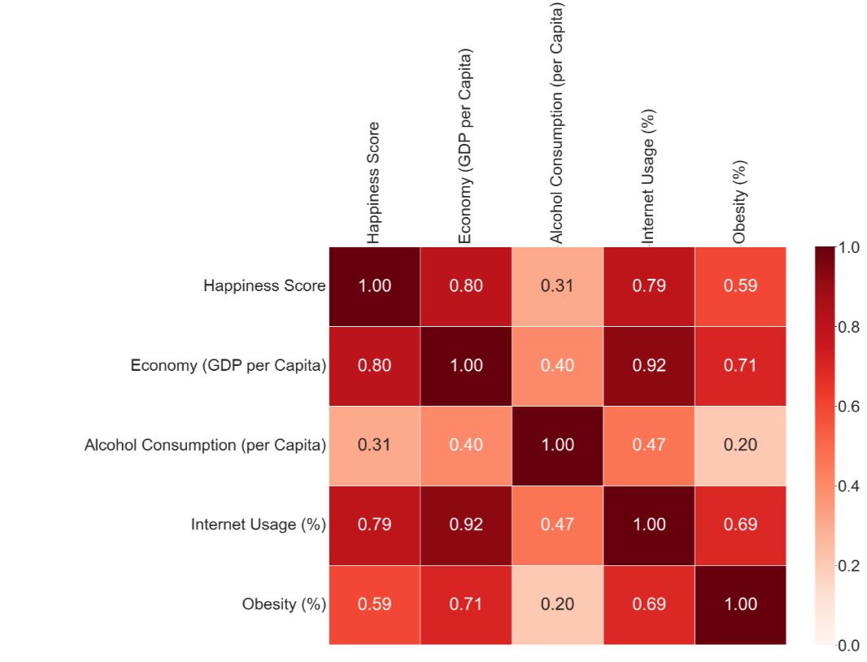
Correlation Matrix
Notes:
A correlation matrix is a table showing correlation coefficients between variables. Each cell in the table shows the correlation between two variables. A correlation matrix is used to summarize data, as an input into a more advanced analysis, and as a diagnostic for advanced analyses.

Slide 10
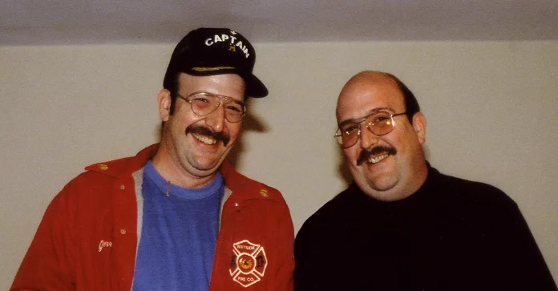
Happiness Pie Chart
Genetics → Happiness gene ??
Genetic variants associated with happiness
Life Circumstances → Incidental activities
Personal experiences, Life status variables such as marital status, occupational status, job security, income, and health
Intentional Activities → Most promising factor, includes behavioral activities:
Exercise
Alcohol consumption
Internet addiction
Eating habits
Generosity
Resource:
https://www.edbatista.com/2017/12/understanding-the-pie-chart-in-the-how-of-happiness.html
https://worldhappiness.report/ed/2022/
Numbers are approximate!
Notes:
In the recent years appeared a new branch of human psychobiology: a genetic approach to well-being and happiness. Twin studies suggested that genetic factors count for 35 -50 percent of happiness (5).
To the extent that it leads to increases in purchasing power, increases in income are associated with increases in happiness (Diener, Oishi, & Ryan, 2013). However, income within societies appears to correlate with happiness only up to a point.
http://sonjalyubomirsky.com/wp-content/themes/sonjalyubomirsky/papers/LSS2005.pdf
https://www.medicalnewstoday.com/articles/309537
https://greatergood.berkeley.edu/article/item/genetics_of_happiness

